Slide 1
Quick recap

Slide 2
Population mean and variance
How can we think of the population mean of a random variable?
The population mean is the
long run average
value of a random variable.
So if we played the lottery again, and again, and again, infinitely many times, the average amount we win in the long run is -$1.20.
In an experiment with binomially distributed outcomes and parameters n and p, the long-run average number of successes is n*p.

Slide 3
Population mean and variance
How can we think of the population variance of a random variable?
The population variance is the
long run variance
value of a random variable.

Slide 4
Adding means and variances
Suppose that the graduate student’s experimental runs are independent, and the probability of success on the first experiment was 0.75, the probability of success on the second experiment was 0.75, and the probability of success on the third experiment was 0.75.
What's the long run mean number of successes?

Slide 5
Adding means and variances
Suppose that the graduate student’s experimental runs are independent, and the probability of success on the first experiment was 0.75, the probability of success on the second experiment was 0.75, and the probability of success on the third experiment was 0.75.
What's the long run mean number of successes?
Mean # successes over 3 experiments
= mean number of successes in 1st experiment +
mean number of successes in 2nd experiment +
mean number of successes in 3st experiment
= 0.75 + 0.75 + 0.75
= 2.25

Slide 6
Adding means and variances
Suppose that the graduate student’s experimental runs are independent, and the probability of success on the first experiment was 0.75, the probability of success on the second experiment was 0.75, and the probability of success on the third experiment was 0.75.
What's the long run mean number of successes?
Mean # successes over 3 experiments
= mean number of successes in 1st experiment +
mean number of successes in 2nd experiment +
mean number of successes in 3st experiment
= 0.75 + 0.75 + 0.75
= 2.25
Assumes that experiments are independent!

Slide 7
Quiz: Adding means and variances
Suppose that the graduate student’s experimental runs were still independent, but the probability of success on the first experiment was 0.2, the probability of success on the second experiment was 0.5, and the probability of success on the third experiment was 0.9.

Slide 8
Quiz: Adding means and variances
Suppose that the graduate student’s experimental runs were still independent, but the probability of success on the first experiment was 0.2, the probability of success on the second experiment was 0.5, and the probability of success on the third experiment was 0.9.
Long-run mean # sucesses
= 0.2 + 0.5 + 0.9
= 1.6
This means that if we took the average over lots and lots of graduate students with these success probabilities, the average number of successes over all graduate students would be 1.6

Slide 9
Probability Distributions
II

Slide 10
Multinomial Distribution - Motivation
Suppose we modified assumption (1) of the binomial distribution to allow for more than two outcomes.
For example, suppose that for the family with parents that are heterozygote carriers of a recessive trait, we are interested in knowing the probability of
Q₁: One of their n=3 offspring will be unaffected (AA), 1 will be affected (aa) and one will be a carrier (Aa),
Q₂:All of their offspring will be carriers,
Q₃:Exactly two of their offspring will be affected (aa) and one will be a carrier.

Slide 11
Multinomial Probabilities
What is the probability that a multinomial random variable with n trials and success probabilities p₁, p₂, …, p_{J} will yield exactly k₁, k₂,…k_{J} successes?
Assumptions:
1) J possible outcomes – only one of which can be a success (1) a given trial.
2) The probability of success for each possible outcome, p_{j}, is the same from trial to trial.
3) The outcome of one trial has no influence on other trials (independent trials).
4) Interest is in the (sum) total number of “successes” over all the trials.
k₁ k₂ k₃ k₄
k_{J-1} k_{J}
n = Σ_{j} k_{j} is the total number of trials.

Slide 12
Multinomial Probabilities - Examples
Returning to the original questions:
Q₁: One of n=3 offspring will be unaffected (AA), one will be affected (aa) and one will be a carrier (Aa) (recessive trait, carrier parents)?
Solution: For a given child, the probabilities of the three outcomes are:
p₁ = Pr[AA] = 1/4, p₂ = Pr[Aa] = 1/2, p₃ = Pr[aa] = 1/4.
We have

Slide 13
Quiz
What is the probability that all three offspring will be carriers?
What is the probability that exactly two offspring will be affected and one a carrier?

Slide 14
Solutions
Q₂: What is the probability that all three offspring will be carriers?
Q₃: What is the probability that exactly two offspring will be affected and one a carrier?

Slide 15
Example - Mean and Variance
It turns out that the (marginal) outcomes of the multinomial distribution are binomial. We can immediately obtain the means for each outcome (i.e., the j^{th} cell) MEAN:
VARIANCE:
COVARIANCE:

Slide 16
Multinomial Distribution Summary
Multinomial
1. Discrete, bounded
2. Parameters - n, p₁, p₂,…,p_{J}
Sum of n independent outcomes
Extends binomial distribution
5. Polytomous regression, contingency tables

Slide 17
Continuous Distributions

Slide 18
Continuous Distributions
For measurements like height and weight which can be measured with arbitrary precision, it does not make sense to talk about the probability of any single value. Instead we talk about the probability for an interval.
P[weight = 70.000kg] ≈ 0
P[69.0kg < weight < 71.0kg] = 0.08
For discrete random variables we had a probability mass function to give us the probability of each possible value. For continuous random variables we use a probability density function to tell us about the probability of obtaining a value within some interval.

Slide 19
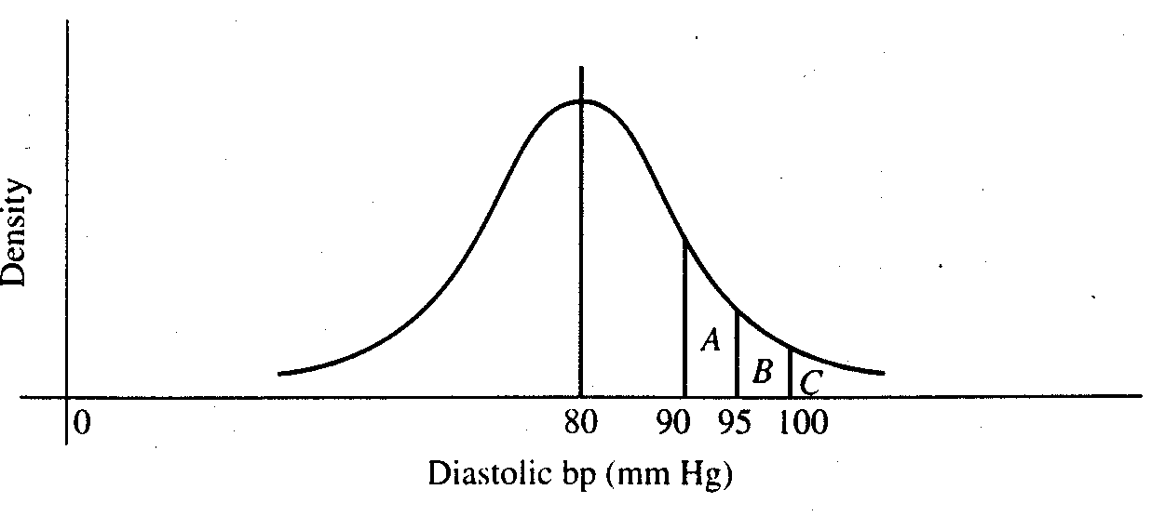
With discrete probability distributions, we can determine the probability of a single outcome, e.g.:
With continuous probability distributions, we can determine the probability across a range of outcomes:
For any interval, the area under the curve represents the probability of obtaining a value in that interval.

Slide 20
Probability density function
1. A function, typically denoted f(x), that gives probabilities based on the area under the curve.
2. f(x) > 0
3. Total area under the function f(x) is 1.0.
Cumulative distribution function
The cumulative distribution function, F(t), tells us the total probability less than some value t.
F(t) = P(X < t)
This is analogous to the cumulative relative frequency.

Slide 21
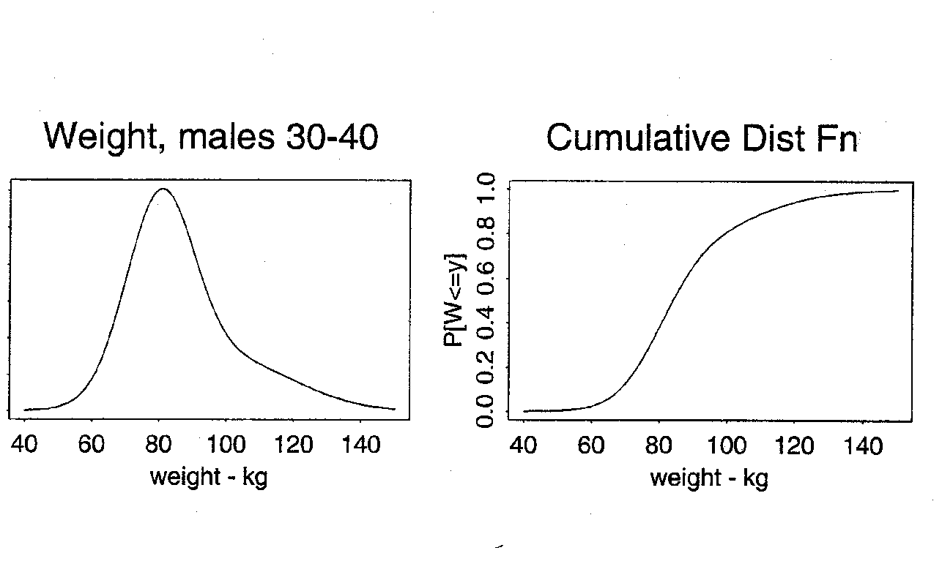
Prob[wgt < 80]
Area under the curve
= 0.40

Slide 22
Normal Distribution
A common probability model for continuous data
Bell-shaped curve
takes values between -∞ and + ∞
symmetric about mean
mean=median=mode
Examples (common but questionable!)
birthweights
blood pressure
CD4 cell counts (perhaps transformed)
The normal distribution is more useful
as a derived distribution,
as we will see when we talk about the
central limit theorem…

Slide 23
Normal Distribution
Specifying the mean and variance of a normal distribution completely determines the probability distribution function and, therefore, all probabilities.
The normal probability density function is:
where
π ≈ 3.14 (a constant)
Notice that the normal distribution has two parameters:
μ = the mean of X
σ = the standard deviation of X
We write X~N(μ , σ²). The standard normal distribution is a special case where μ = 0 and σ = 1.

Slide 24
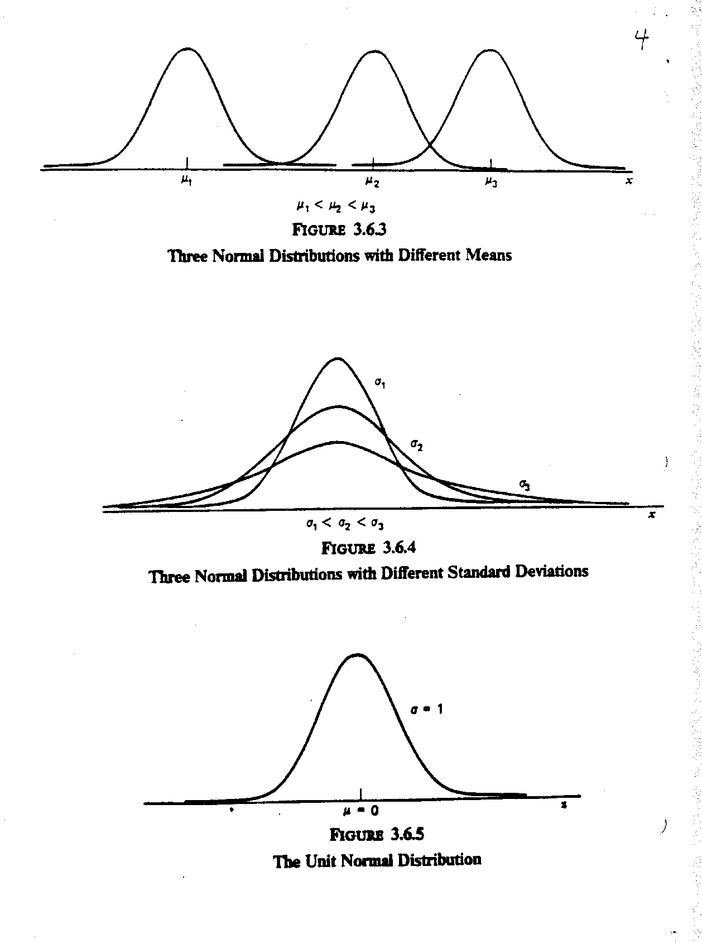

Slide 25
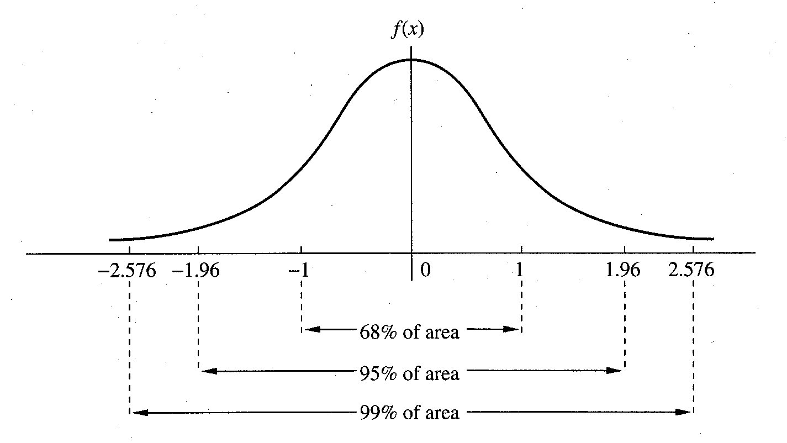

Slide 26
Normal Distribution - Calculating Probabilities
Example: Rosner 5.20
Serum cholesterol is approximately normally distributed with mean 219 mg/mL and standard deviation 50 mg/mL. If the clinically desirable range is < 200 mg/mL, then what proportion of the population falls in this range?
X = serum cholesterol in an individual.
μ =
σ =
negative values for cholesterol - huh?

Slide 27
Standard Normal Distribution - Calculating Probabilities
First, let’s consider the standard normal - N(0,1). We will usually use Z to denote a random variable with a standard normal distribution. The density of Z is
and the cumulative distribution of Z is:
Any computing software can give you the values of f(z) and Φ(z)

Slide 28
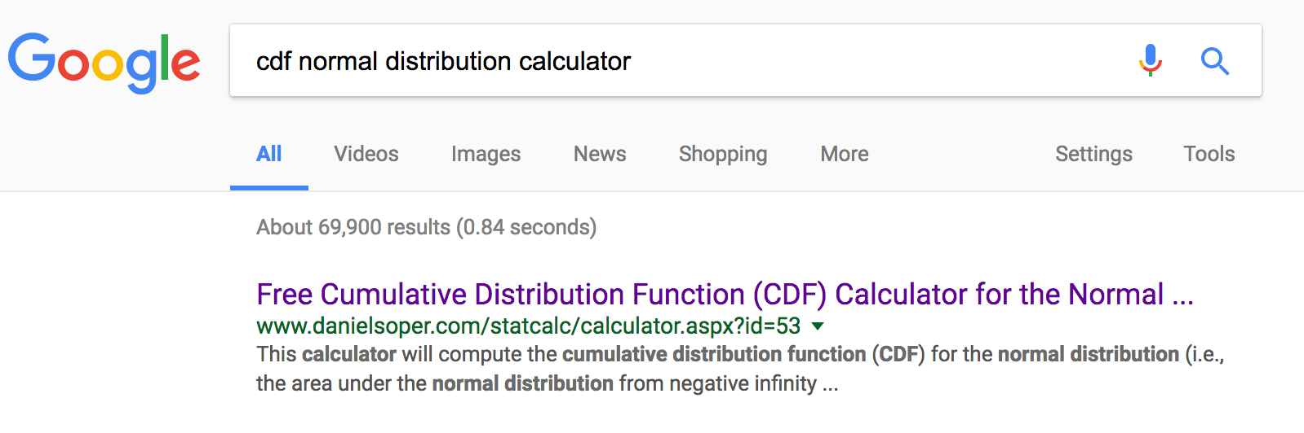
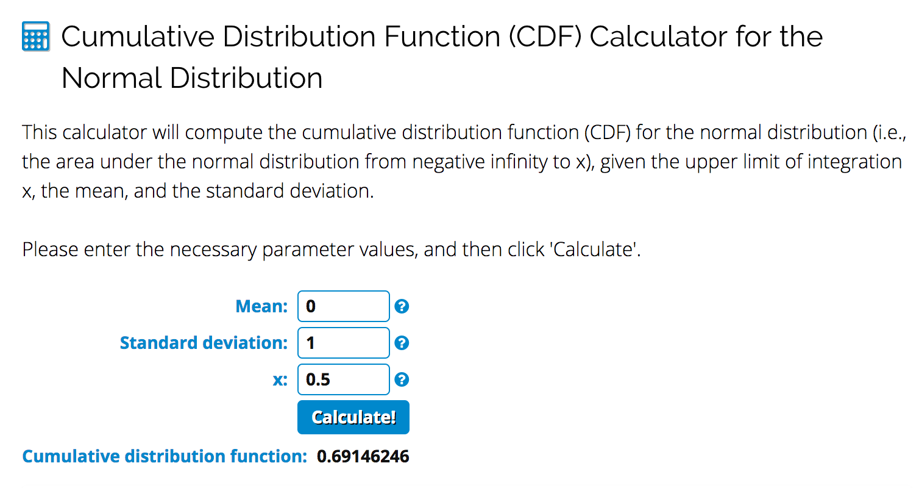
Standard Normal Distribution - Calculating Probabilities

Slide 29
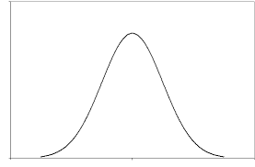
Facts about probability distributions
P[Z < z] = a
P[Z > z] = 1-a
P[Z < x] = b, P[Z < y] = c
Pr[x < Z < y ] = c-b
a
1-a
c
b
c-b

Slide 30
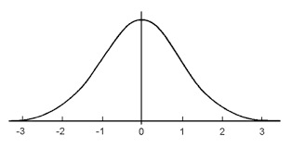
Facts about the standard normal distribution
Because the N(0,1) distribution is symmetric around 0,
Pr[Z < -y] = Pr[Z > y]
y
y

Slide 31
Quiz: 3 minutes
Google “cdf normal distribution calculator” and find the following if Z ~ N(0,1)
P[Z < 1.65] =
P[Z > 0.5] =
P[-1.96 < Z < 1.96] =
P[-0.5 < Z < 2.0] =

Slide 32
Solutions to Quiz
P[Z < 1.65] = 0.9505
P[Z > 0.5] = 1 – 0.6915 = 0.3085
P[-1.96 < Z < 1.96] = 0.975 – 0.025 = 0.95
P[-0.5 < Z < 2.0] = 0.9772 – 0.3085=0.6687

Slide 33
Converting to Standard Normal
This solves the problem for the N(0,1) case. Do we need a special table for every (μ,σ)?
No!
Define: X = μ + σZ where Z ~ N(0,1)
1. E(X) = μ + σE(Z) = μ
2. V(X) = σ²V(Z) = σ².
3. X is normally distributed!
Linear functions of normal RV’s are also normal.
If X ~ N (μ, σ²) and Y = aX + b
then
Y ~ N(aμ + b, a ²σ²)

Slide 34
Converting to Standard Normal
How can we convert a N(μ,σ²) to a standard normal?
Standardize:
What is the mean and variance of Z?
1. E(Z) = (1/ σ)E(X - μ) = 0
2. V(Z) = (1/ σ²)V(X) = 1

Slide 35
Normal Distribution - Calculating Probabilities
Return to cholesterol example (Rosner 5.20)
Serum cholesterol is approximately normally distributed with mean 219 mg/mL and standard deviation 50 mg/mL. If the clinically desirable range is < 200 mg/mL, then what proportion of the population falls in this range?
P( Z > 0.38)
= 0.3520.

Slide 36
Normal Approximation to Binomial
Example
Suppose the prevalence of HPV in women 18 -22 years old is 0.30. What is the probability that in a sample of 60 women from this population 9 or fewer would be infected?

Slide 37
Normal Approximation to Binomial
Example
Suppose the prevalence of HPV in women 18 -22 years old is 0.30. What is the probability that in a sample of 60 women from this population 9 or fewer would be infected?

Slide 38
Normal Approximation to Binomial
Binomial
When np(1-p) is “large” the normal may be used to approximate the binomial.
X ~ bin(n,p)
E(X) = np
V(X) = np(1-p)
X is approximately N(np,np(1-p))

Slide 39
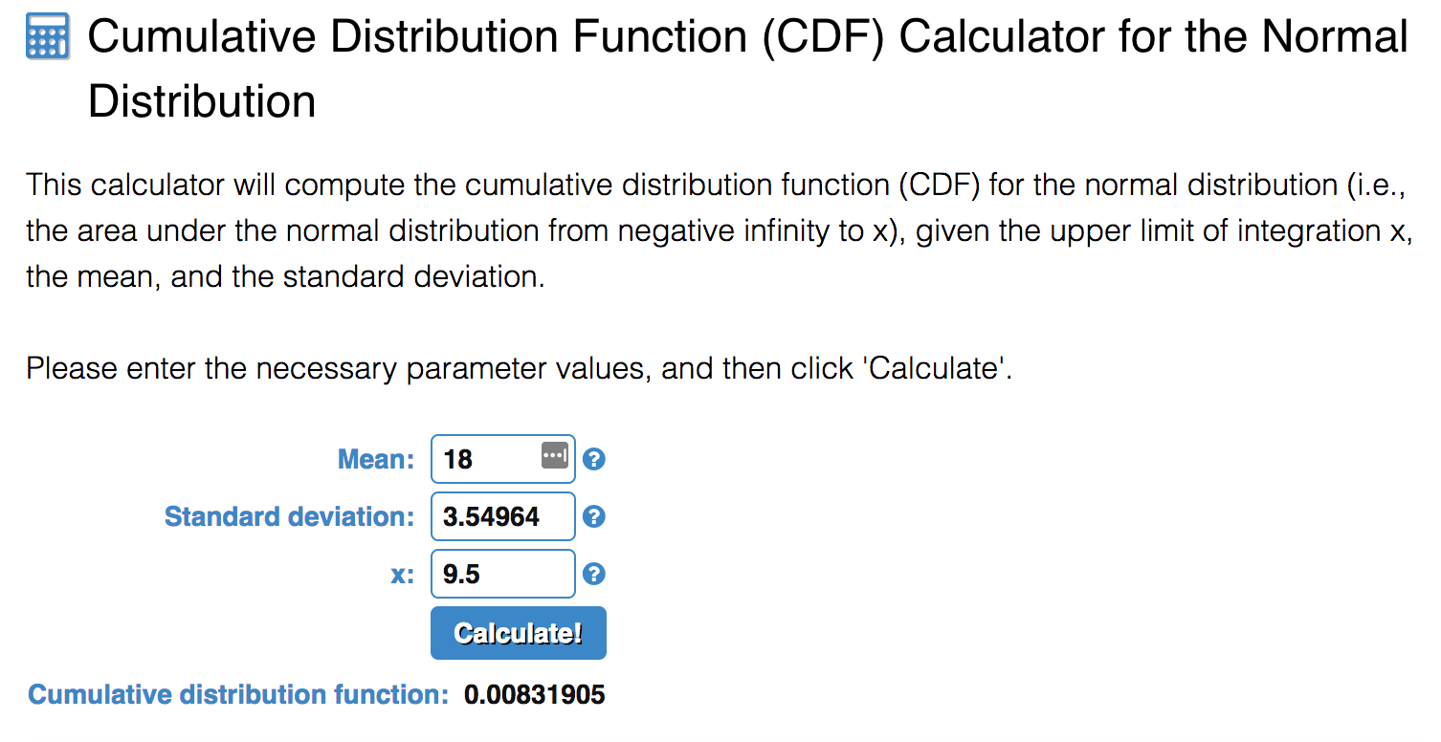
Normal Approximation to Binomial
Example
Suppose the prevalence of HPV in women 18 -22 years old is 0.30. What is the probability that in a sample of 60 women from this population that 9 or less would be infected?
Solution
X = number infected out of 60
X ~ Binomial(n=60, p =0.3)
X close to Normal distribution with mean 60*0.3=18 and variance 0.6*0.3*(1-0.3)=12.6

